Slide 1
Web and mobile app development – csc3054/7054
2.3 Event handling for silent toggle mode

Slide 2
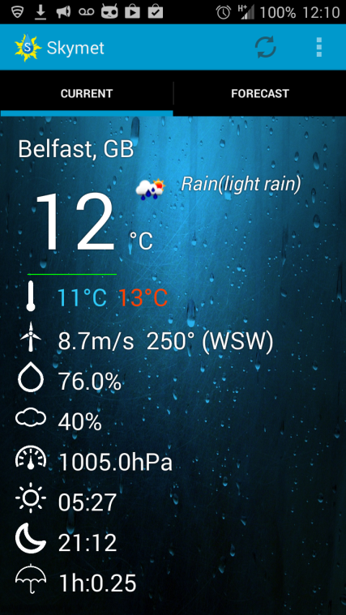
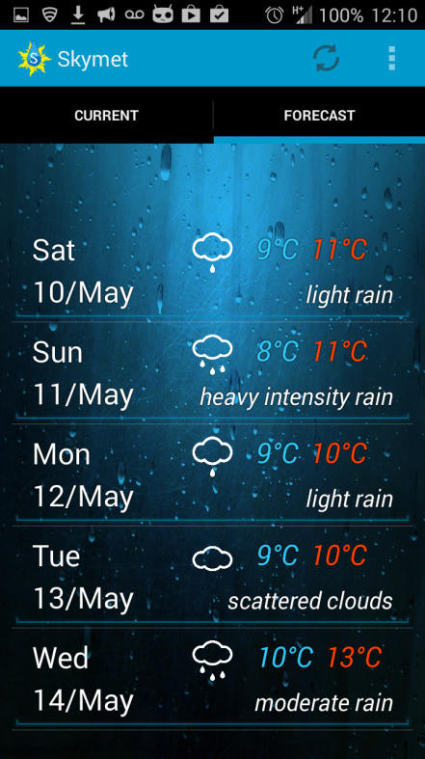
“skymet” application
To provide both current and forecasted weather for a user-specified location.
current
forecasted

Slide 3
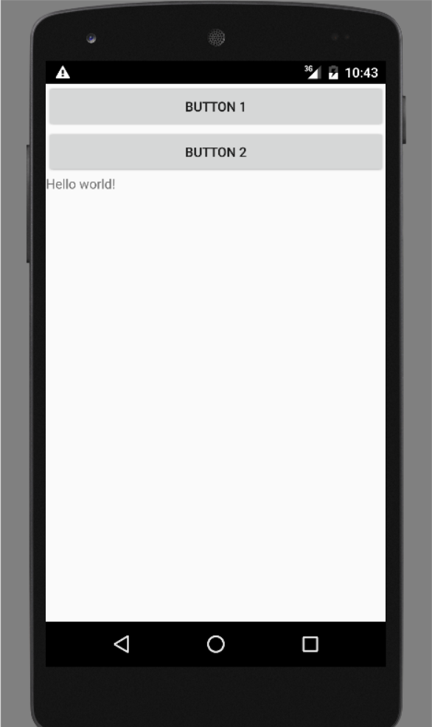
What we discussed in the last lecture?
Event handler
Layout of the application
LinearLayout?
Button?
TextView?

Slide 4
Question to be answered
What is Android activity?
Can you describe Android activity’s life cycle?
How do you set up ClickListener and Click methods?
How can you check if the phone is silent or not?
How to make toggle services for the app?

Slide 5
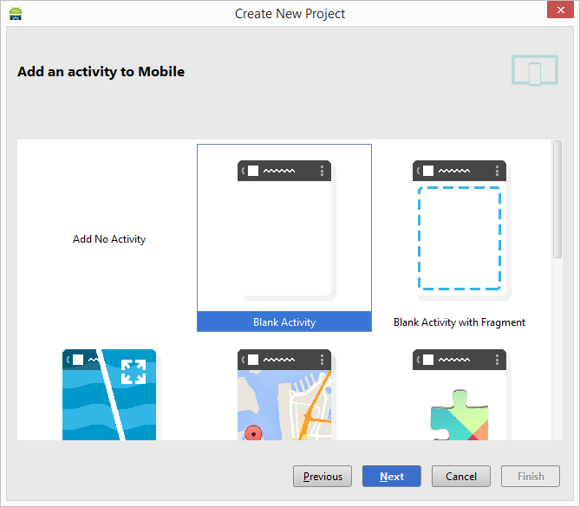
when “hello world” app is created…

Slide 6
Content outline
Activity
Event handler
Summary
Next lecture
Further readings

Slide 7
Activities – basics
An activity is a single and focused thing that a user can do, e.g. change images or turn off audio.
An Android application may consist of many activities.
Each activity is implemented as an implementation of the Activity base class.

Slide 8
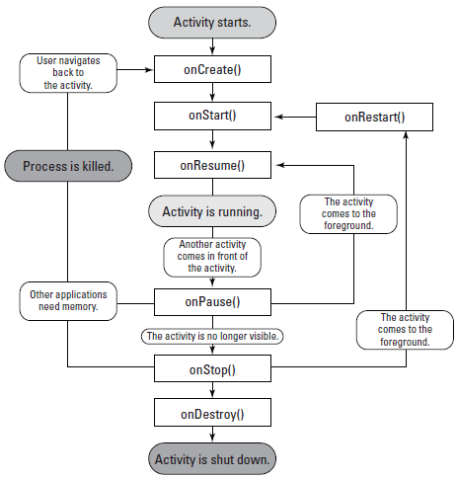
activity’s life cycle of an android app

Slide 9
Key stages/steps
The entire lifetime: put on global set-up in onCreate() and releases all remaining recourses in onDestroy().
The visible lifetime: the user can see the activity between onStart() and onStop() methods.
The foreground lifetime: between onResume() and onPause(), the activity is interacting with the user in front of other activities.

Slide 10
To Create first activity
onCreate() method in the application:
public class MainActivity extends AppCompatActivity {
/** Called when the activity is first created. */
@Override
public void onCreate(Bundle savedInstanceState) {
super.onCreate(savedInstanceState);
setContentView(R.layout.activity_main);
}
}

Slide 11
Explanations to the code
super.onCreate(savedInstanceState);
Calls to the base Activity class to perform setup work for the MainActivity class.
Bundle savedInstanceState
Gives the developer a way to pass information back and forth between screens (different activities) in what is known as a bundle.

Slide 12
To allow android to display the ui
setContentView(R.layout.activity_main);
R.layout.activity_main is the activity_main.xml file that is located in the res/layouts directory.

Slide 13
Content outline
Activity
Event handler
Summary
Next lecture
Further readings

Slide 14
Handling user input
Events in Android have different forms, usually generated in response to external actions.
Event are placed as they occur and removed on a first-in and first-out basis.
The Android View class, where user interface components come from, contains a set of event listener interfaces, each of which has a declaration for a callback method e.g. onClick().

Slide 15
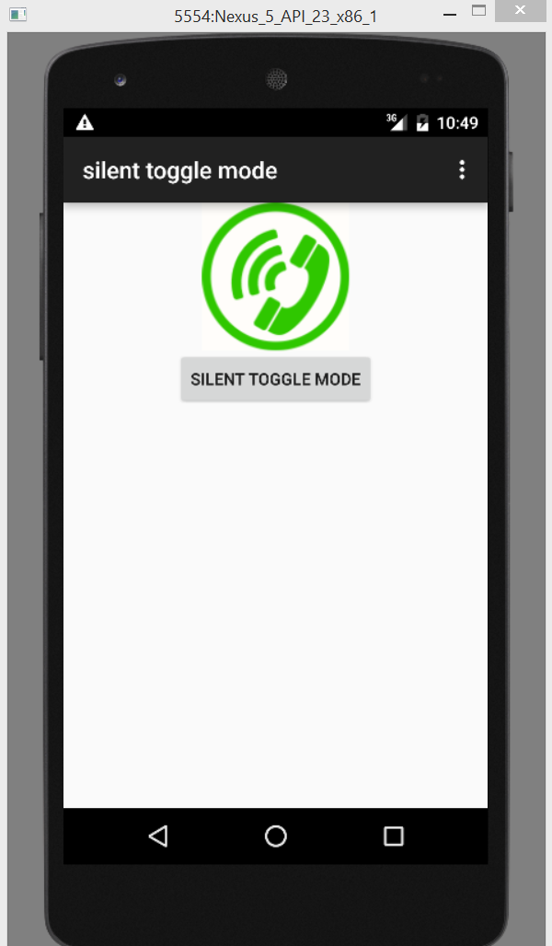
Writing our event handler
Register an onClickListener() method to a button view.
When the user clicks the button, check if the phone is silent.
Implement an onClick() callback method.
Conduct the toggle service as appropriate.

Slide 16
Start making event handler
Initiate class file with a default button onClickListener:
@Override
public void onCreate(Bundle savedInstanceState) {
super.onCreate(savedInstanceState);
setContentView(R.layout.activity_main);
Button toggleButton = (Button)findViewById(R.id.toggleButton);
toggleButton.setOnClickListener(new View.OnClickListener() {
public void onClick(View v) {
}
});
}

Slide 17
Continued…
Casting the returned View from findViewById() to a Button:
Button toggleButton = (Button)findViewById(R.id.toggleButton);

Slide 18
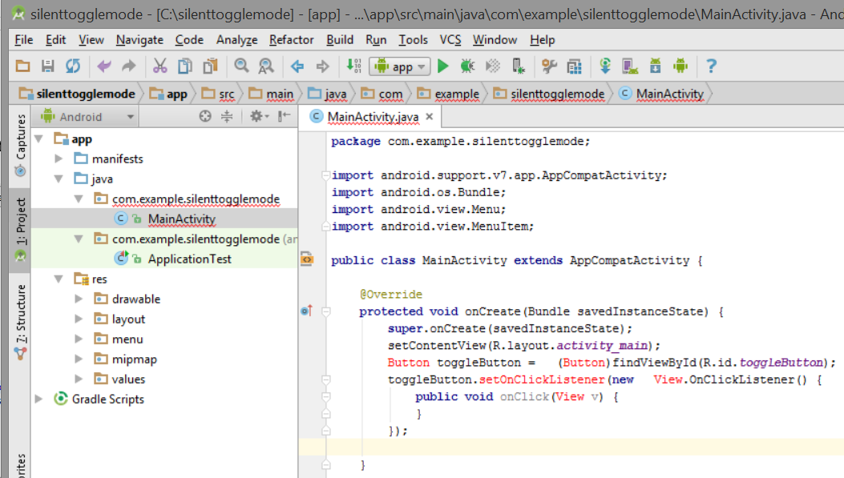
What we see…
Red highlights indicate errors after we change onCreate():

Slide 19
Event handler registration
Take out the new button code and put it into a method so that we can call this method from inside of onCreate():
public class MainActivity extends AppCompatActivity {
/** Called when the activity is first created. */
@Override
public void onCreate(Bundle savedInstanceState) {
super.onCreate(savedInstanceState);
setContentView(R.layout.activity_main);
setButtonClickListener();
}
private void setButtonClickListener() {
Button toggleButton = (Button)findViewById(R.id.toggleButton);
toggleButton.setOnClickListener(new View.OnClickListener() {
public void onClick(View v) {
// TODO Auto-generated method stub
}
});
}
}

Slide 20
Access android ringer
import android.graphics.drawable.Drawable;
import android.support.v7.app.AppCompatActivity;
import android.os.Bundle;
import android.view.Menu;
import android.view.MenuItem;
import android.media.AudioManager;
import android.view.View;
import android.widget.Button;
import android.widget.ImageView;
public class MainActivity extends AppCompatActivity {
private AudioManager mAudioManager;
private Boolean mPhoneIsSilent;
@Override
public void onCreate(Bundle savedInstanceState) {
super.onCreate(savedInstanceState);
setContentView(R.layout.activity_main);

Slide 21
Continued…
mAudioManager = (AudioManager)getSystemService(AUDIO_SERVICE);
checkIfPhoneIsSilent();
setButtonClickListener();
}
private void setButtonClickListener() {
Button toggleButton = (Button) findViewById(R.id.toggleButton);
toggleButton.setOnClickListener(new View.OnClickListener() {
public void onClick(View v) {
// See the code to be added
}
});
}
}

Slide 22
Explanations…
Import statement: bring in the AudioManager.
private AudioManager: access to it in other parts of the activity.
mAudioManager: to get service from the base Activity getSystemService() method, e.g. setRingerMode() for vibrate/normal/silent.

Slide 23
Event handler
public void onClick(View v) {
if (mPhoneIsSilent) {
// Change back to normal mode
mAudioManager
.setRingerMode(AudioManager.RINGER_MODE_NORMAL);
mPhoneIsSilent = false;
} else {
// Change to silent mode
mAudioManager
.setRingerMode(AudioManager.RINGER_MODE_SILENT);
mPhoneIsSilent = true;
}
// Now toggle the UI again
toggleUi();
}

Slide 24
Event handler
private void checkIfPhoneIsSilent() {
int ringerMode = mAudioManager.getRingerMode();
if (ringerMode == AudioManager.RINGER_MODE_SILENT) {
mPhoneIsSilent = true;
} else {
mPhoneIsSilent = false;
}
}
/**Toggles the UI images from silent to normal and vice versa */
private void toggleUi() {
ImageView imageView = (ImageView) findViewById(R.id.phone_icon);
Drawable newPhoneImage;
if (mPhoneIsSilent) {

Slide 25
Event handler
newPhoneImage =
getResources().getDrawable(R.drawable.phone_off);
} else {
newPhoneImage =
getResources().getDrawable(R.drawable.phone_on);
}
imageView.setImageDrawable(newPhoneImage);
}
@Override
protected void onResume() {
super.onResume();
checkIfPhoneIsSilent();
toggleUi();
}

Slide 26
Content outline
Activity
Event handler
Summary
Next lecture
Further readings

Slide 27
Summary
Described Android activity’s life cycle.
Created a working silent toggle mode app using a button to control.

Slide 28
Content outline
Activity
Event handler
Summary
Next lecture
Further readings

Slide 29
next lecture
To create a home-screen widget app.

Slide 30
Content outline
Activity
Event handler
Summary
Next lecture
Further readings

Slide 31
Further readings
http://developer.android.com/training/index.html
Android Application Development for Dummies, Donn Felker, Wiley Publishing, Inc., NJ, 2011.

